Slide 1
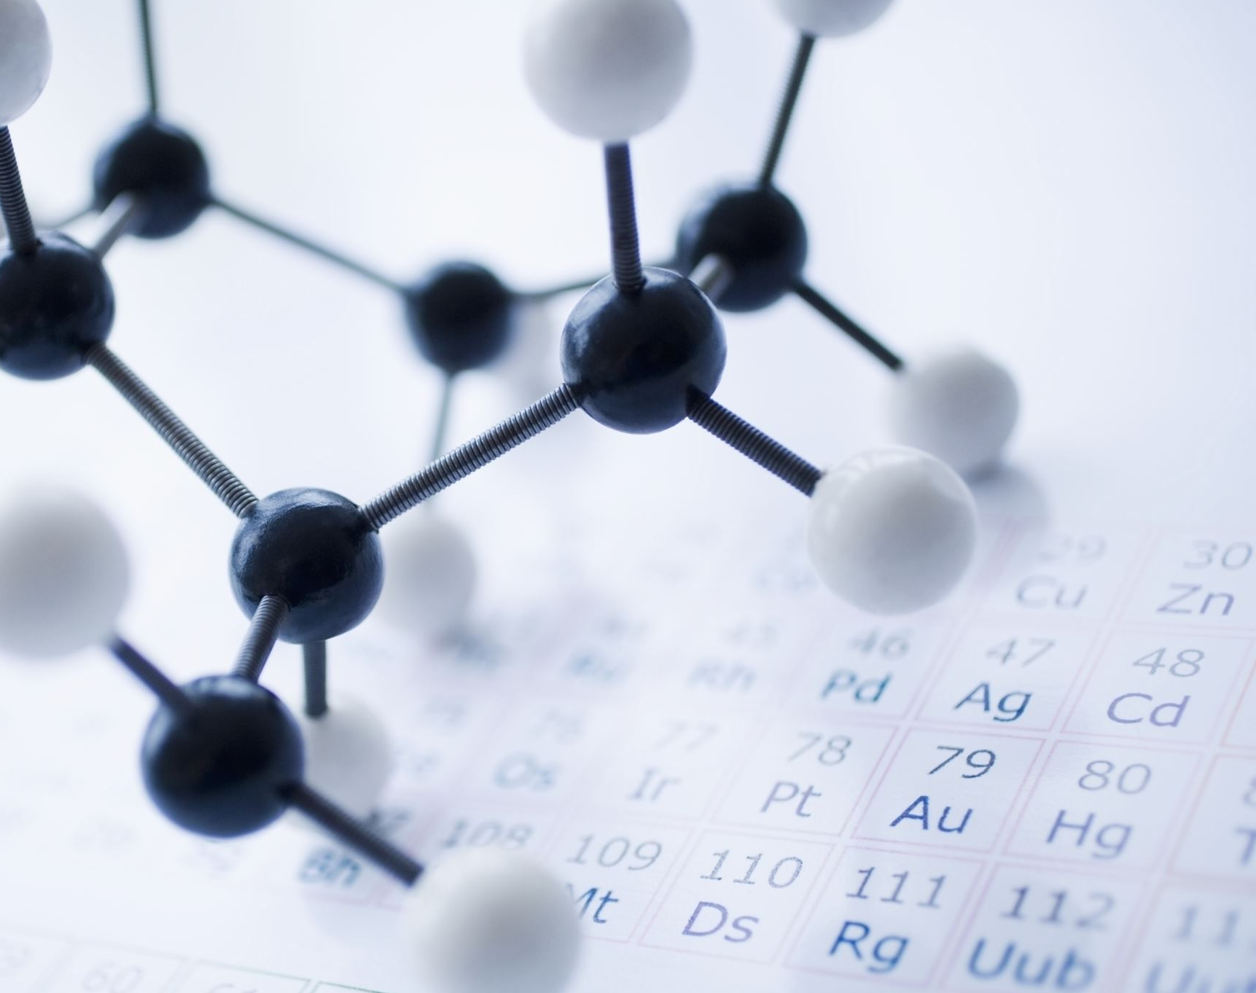
Hyperparameter Tuning using Genetic Algorithm
Ahmed Samir Afifi

Slide 2
Project Description
A genetic algorithm is a search heuristic that is inspired by natural evolution theory.
This algorithm reflects the process of natural selection where the fittest individuals are selected for reproduction in order to produce offspring of the next generation.
Usually used for optimization purpose
We used GA to choose best parameters for our machine learning model
SVM and KNN Models is tested on diabetes disease dataset
Hyperparameters is selected based on GA search

Slide 3
Data Description
This dataset is originally from the National Institute of Diabetes and Digestive and Kidney Diseases. The objective is to predict based on diagnostic measurements whether a patient has diabetes.
Columns:
Pregnancies: Number of times pregnant
Glucose: Plasma glucose concentration a 2 hours in an oral glucose tolerance test
BloodPressure: Diastolic blood pressure (mm Hg)
SkinThickness: Triceps skin fold thickness (mm)
Insulin: 2-Hour serum insulin (mu U/ml)
BMI: Body mass index (weight in kg/(height in m)^2)
DiabetesPedigreeFunction: Diabetes pedigree function
Age: Age (years)
Outcome: Class variable (0 or 1)

Slide 4
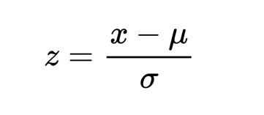
Data Preparation
In order to feed the data to the model we had apply scaling techniques to make it easier for the model to learn different patterns in the data.
Sklearn python library provides some different techniques to deal with, one of the most used is StandardScaler represented in the following equation

Slide 5
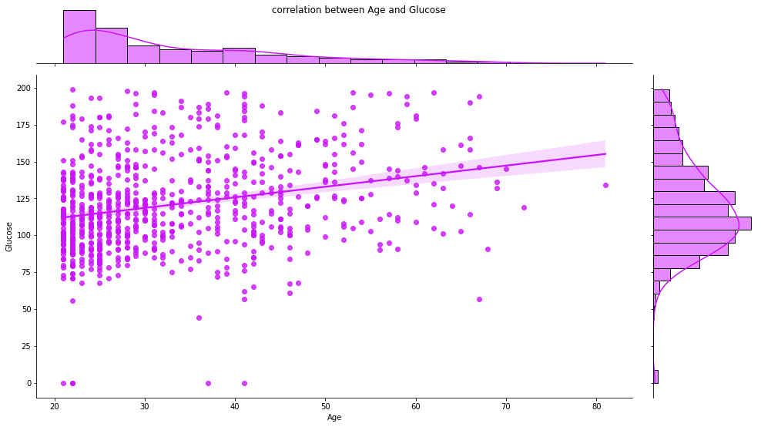
Data Visualization

Slide 6
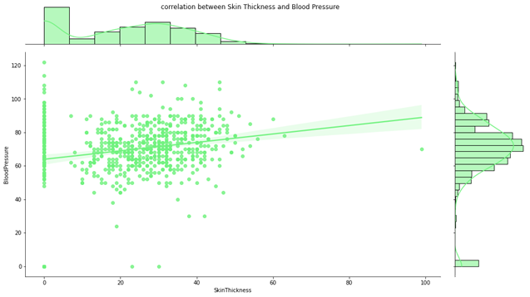
Data Visualization

Slide 7
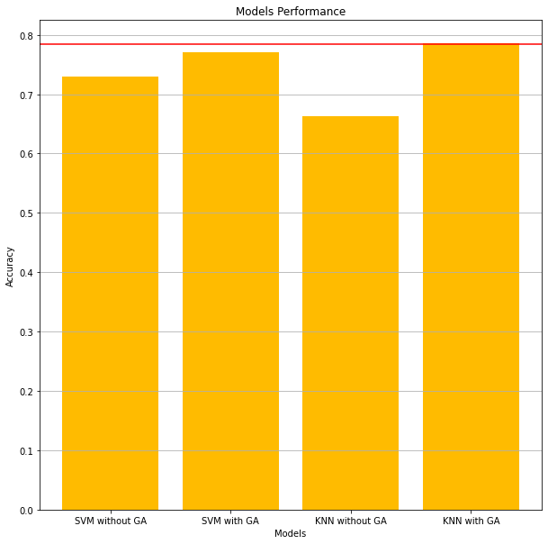
Results
According to Kaggle the competitors achieve maximum accuracy at 77% on this dataset
We used SVM and KNN hybrid with genetic algorithm
KNN was the best one at 78% Accuracy on test data

